Slide 1
Sonar Mapping and Object Detection with DE2Bots
Philip Balê, Caitlyn Caggia, Eydan Fishel, Can Kabuloğlu
ECE 2031: Digital Design Lab, GTL
April 25, 2016

Slide 2
Project Objectives
Navigate through 8 feet by 10 feet arena without hitting walls or objects
Detect object locations using sonar
Transmit object coordinates and count via radio signal
Three 60-second trials with three unique patterns
Notes:
Philip

Slide 3
Design Overview
Check the entire center aisle first
Only proceed down branches where the robot can detect the wall from the main aisle
Send coordinates every time a new object is found
Stop the search when:
  6 objects have been found
  The entire search path has been covered
  56 seconds has passed
Notes:
Philip

Slide 4
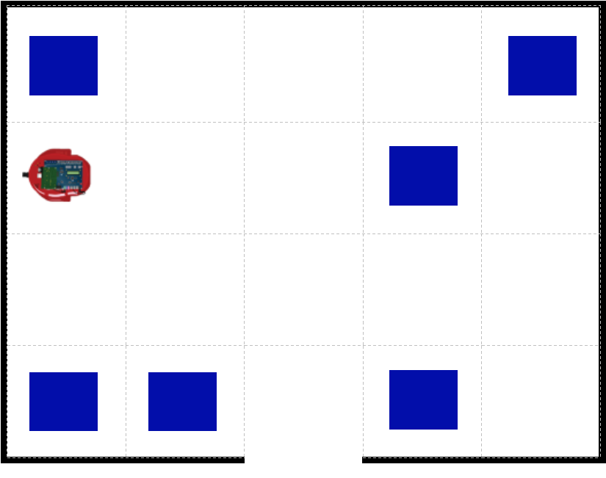
Movement
Straight lines
  Forwards
  Backwards
90 degree turns
  Left
  Right
When checking branches, robot always faces right
DE2Bot image source: DE2Bot User’s Manual
Notes:
This should be a super fast slide, philip

Slide 5
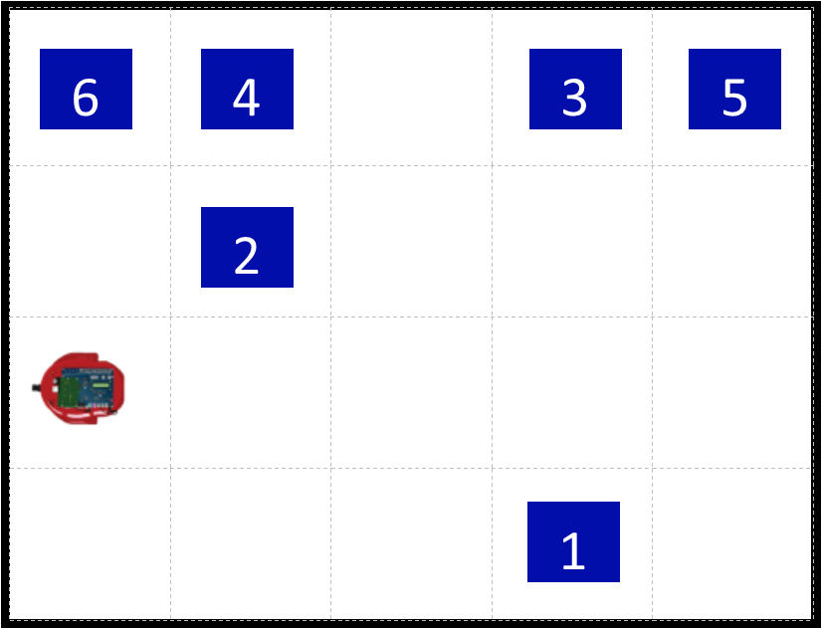
Object Detection
Check along center aisle first
  Scan side sensors (right then left) while moving
Then check branches
  Check no more than two rows on each side
  If both sides were open, check the right first, then go directly to left
Stop any time six objects have been found
DE2Bot image source: DE2Bot User’s Manual
Notes:
Caity
Robot will…
Find box 1 first off the main aisle.
Find box 2 off main aisle
Find box 3, then box 4, on main aisle
Branch right and find 5
Branch down empty row on right
Without facing front again, branch down left
Find box 6
Stop and send object count
(robot is shown in last spot before stopping)

Slide 6
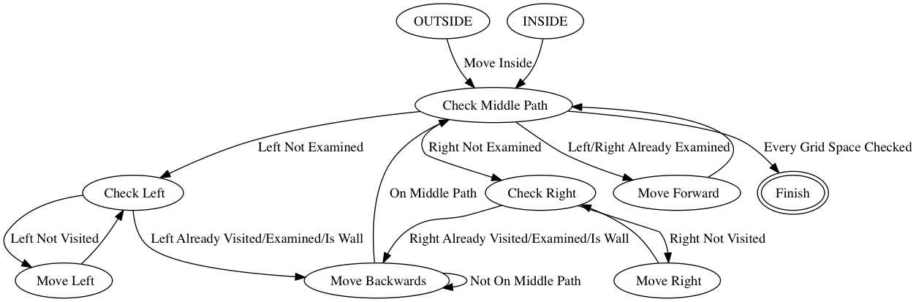
Object Detection
Notes:
Caity
Robot will…
Find box 1 first off the main aisle.
Find box 2 off main aisle
Find box 3, then box 4, on main aisle
Branch right and find 5
Branch down empty row on right
Without facing front again, branch down left
Find box 6
Stop and send object count
(robot is shown in last spot before stopping)

Slide 7
Object Data & Transmission
Store object coordinates in a list
  12 pre-established memory locations (6 sets of x and y)
  Locations were “empty” if coordinates were (0,0)
If the new object doesn’t match any stored objects:
  Immediately transmit the new object’s coordinates
  Update object list
  Increment object count
Notes:
Can

Slide 8
Problems Encountered
Robot movement
  Solution: use as few turns as possible
Tracking location
  Solution: use hard-coded predicted location
Time restrictions
  Solution: new algorithm
Notes:
Can

Slide 9
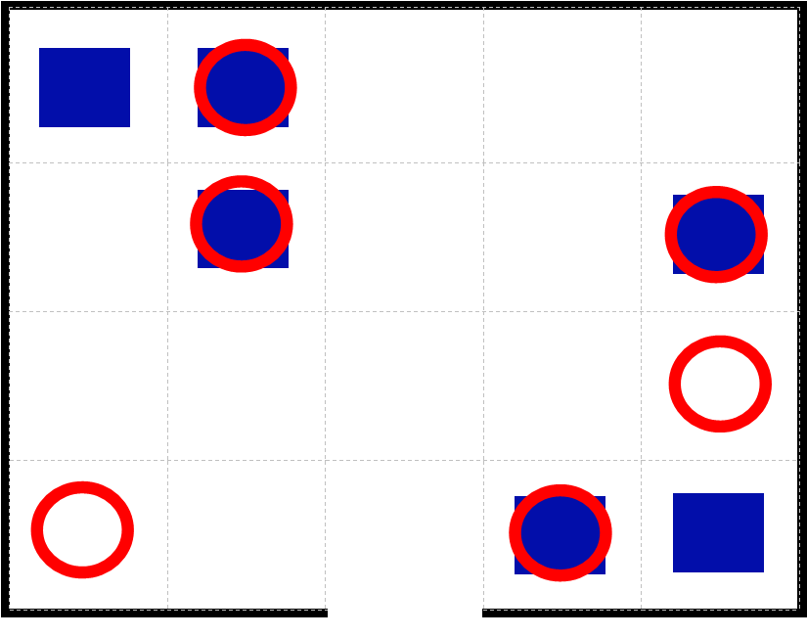
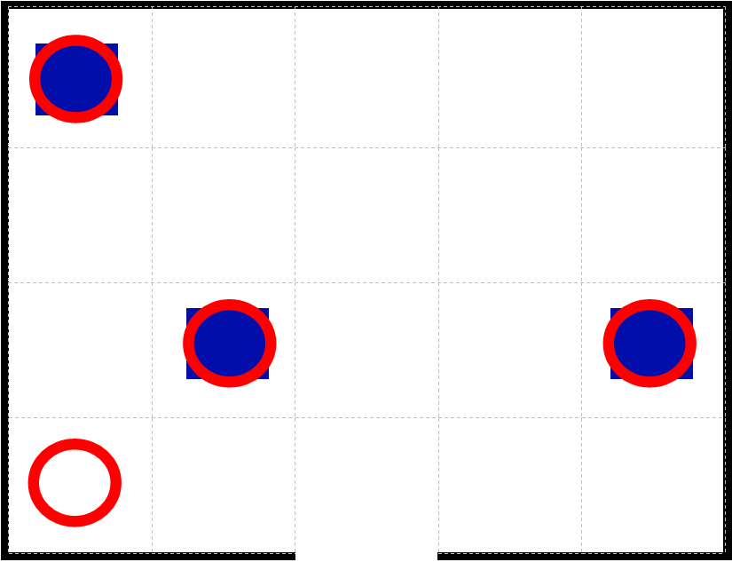
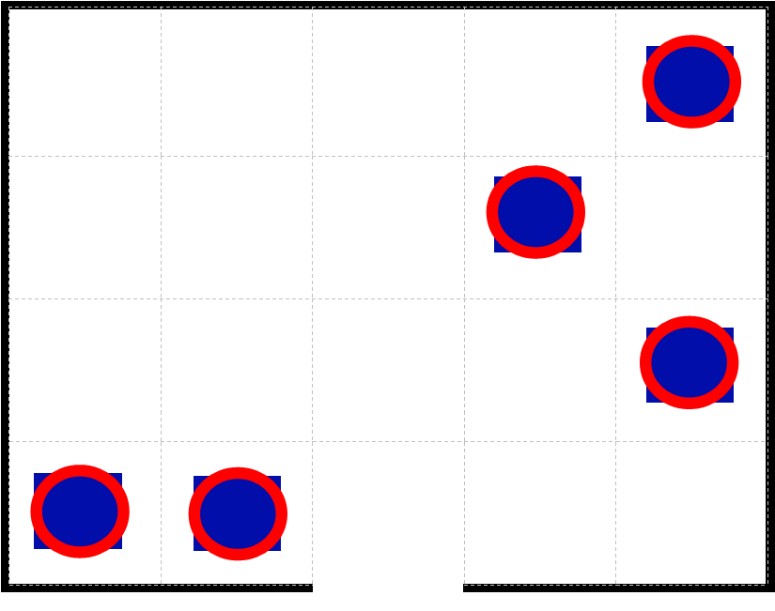
Results
Trial 1
Trial 2
Trial 3
Reported count: 6
Points: 1341
Reported count: 4
Points: 753
Reported count: 5
Points: 1503
TOTAL SCORE: 3597
Notes:
Eydan

Slide 10
Discussion
Changes from our design proposal
  New search algorithm
  Different method to store object locations
  When to send coordinates
Weaknesses
  Dependent on movement accuracy
Strengths
  Contingency plans
Notes:
Eydan

Slide 11
Future Work
Saving time
  Remove pause and have robot scan while moving
Improving accuracy
  Perfect movement functions
  Use robot’s odometry rather than hard coding robot’s location
Notes:
Eydan

